Slide 1
Machine Learning Case Study: Prediction of Neurodevelopmental Disorders from the Electronic Health Record July 11, 2020
MMCi Applied Data Science
Matthew Engelhard

Slide 2
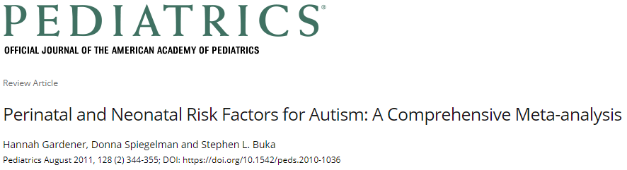
Perinatal and Neonatal Factors (# studies) | Results Across Studies | Summary Effect Estimate (95% CI)
Presentation
Abnormal presentation (15) | 10−, 5↑ | 1.44 (1.07–1.94)
Breech (4) |  | 1.81 (1.21–2.71)
Other perinatal factors
Cord complications (14) | 13−, 1↑ | 1.50 (1.00–2.24)
Fetal distress (4) | 3−, 1↑ | 1.52 (1.09–2.12)
Birth injury or trauma (6) | 6− | 4.90 (1.41–16.94)
Twins or multiple birth (10) | 7−, 3↑ | 1.77 (1.23–2.55)
Maternal hemorrhage (4) | 3−, 1↑ | 2.39 (1.35–4.21)
Birth weight and size
Total birth weight (decreased) (15) | 12−, 2↑, 1↓
Low birth weight (<2500 g) (15) | 8−, 7↑ | 1.63 (1.19–2.33)
Small for gestational age (10) | 7−, 3↑ | 1.35 (1.14–1.61)
Clinical impression
Congenital malformation (11) | 4−, 7↑ | 1.80 (1.42–2.82)
Apgar score
Low 5-minute Apgar score (8) | 6−, 2↑ | 1.67 (1.24–2.26)
Neonatal Status
Feeding difficulties (3) | 2↑, 1− | 3.35 (1.33–8.40)
Meconium aspirated (3) | 2−, 1↑ | 7.34 (2.30–23.47)
Neonatal medical conditions
Anemia (4) | 3−, 1↑ | 7.87 (1.43–43.36)
ABO or Rh incompatible (5) | 4−, 1↑ | 3.70 (1.90–7.23)
Hyperbilirubinemia (6) |  | 1.87 (1.01–3.47)

Slide 3
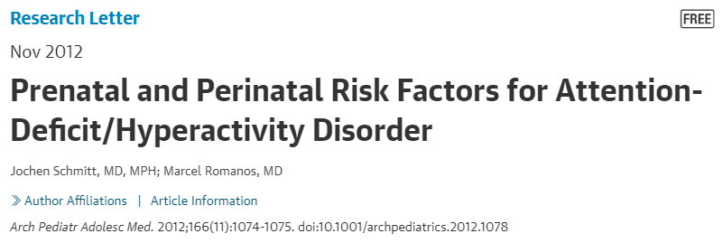
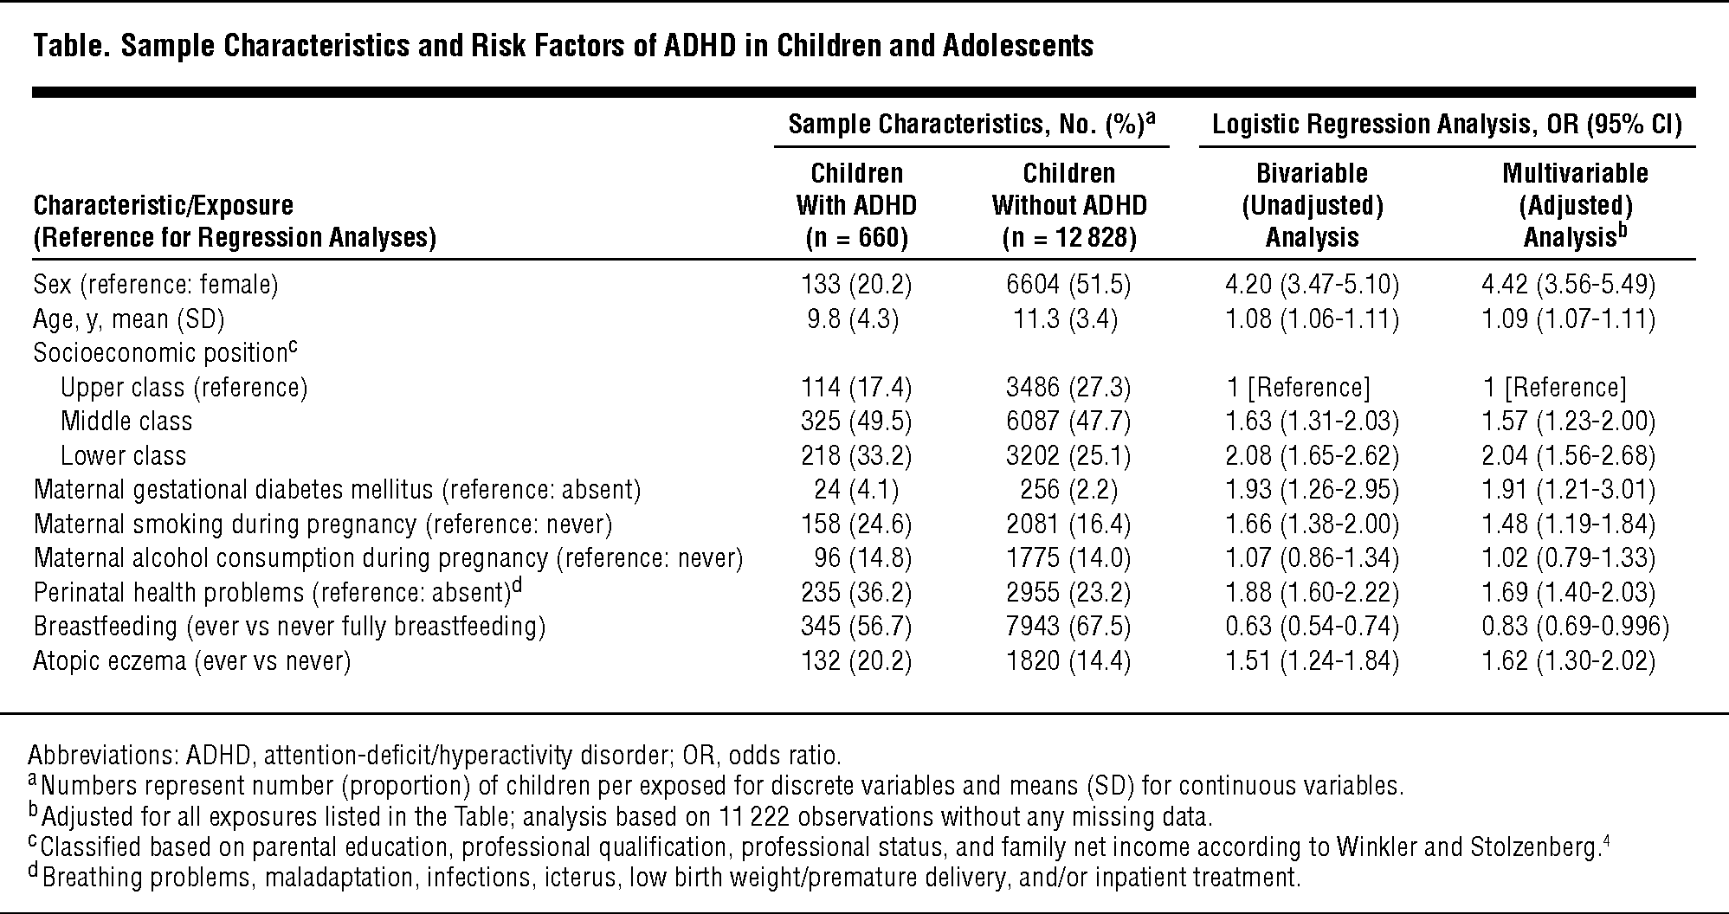


Slide 5
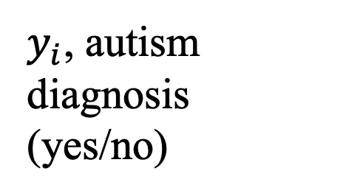
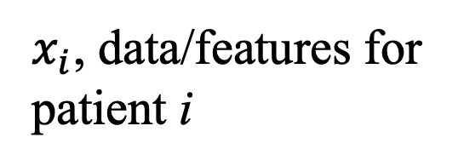
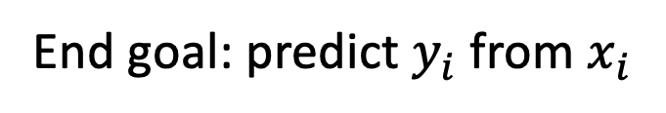
A Simplified Approach…
$y_{i}$, autism diagnosis (yes/no)
$x_{i}$, data/features for patient i
End goal: predict $y_{i}$ from $x_{i}$

Slide 6
A Simplified Approach…
$y_{i}$, autism diagnosis (yes/no)
Labs
Procedures
Demographics
Vitals
Diagnoses
Imaging
Encounters
Notes

Slide 7
What simplifications are we making?
$y_{i}$, autism diagnosis (yes/no)
$x_{i}$, data/features for patient i
End goal: predict $y_{i}$ from $x_{i}$

Slide 8
What simplifications are we making?
$y_{i}$, autism diagnosis (yes/no)
$x_{i}$, data/features for patient i
Diagnoses happen at a particular time…
Notes:
And may happen outside of Duke

Slide 9
What simplifications are we making?
$y_{i}$, autism diagnosis (yes/no)
$x_{i}$, data/features for patient i
Diagnoses happen at a particular time…
and identifying them is not at all straightforward

Slide 10
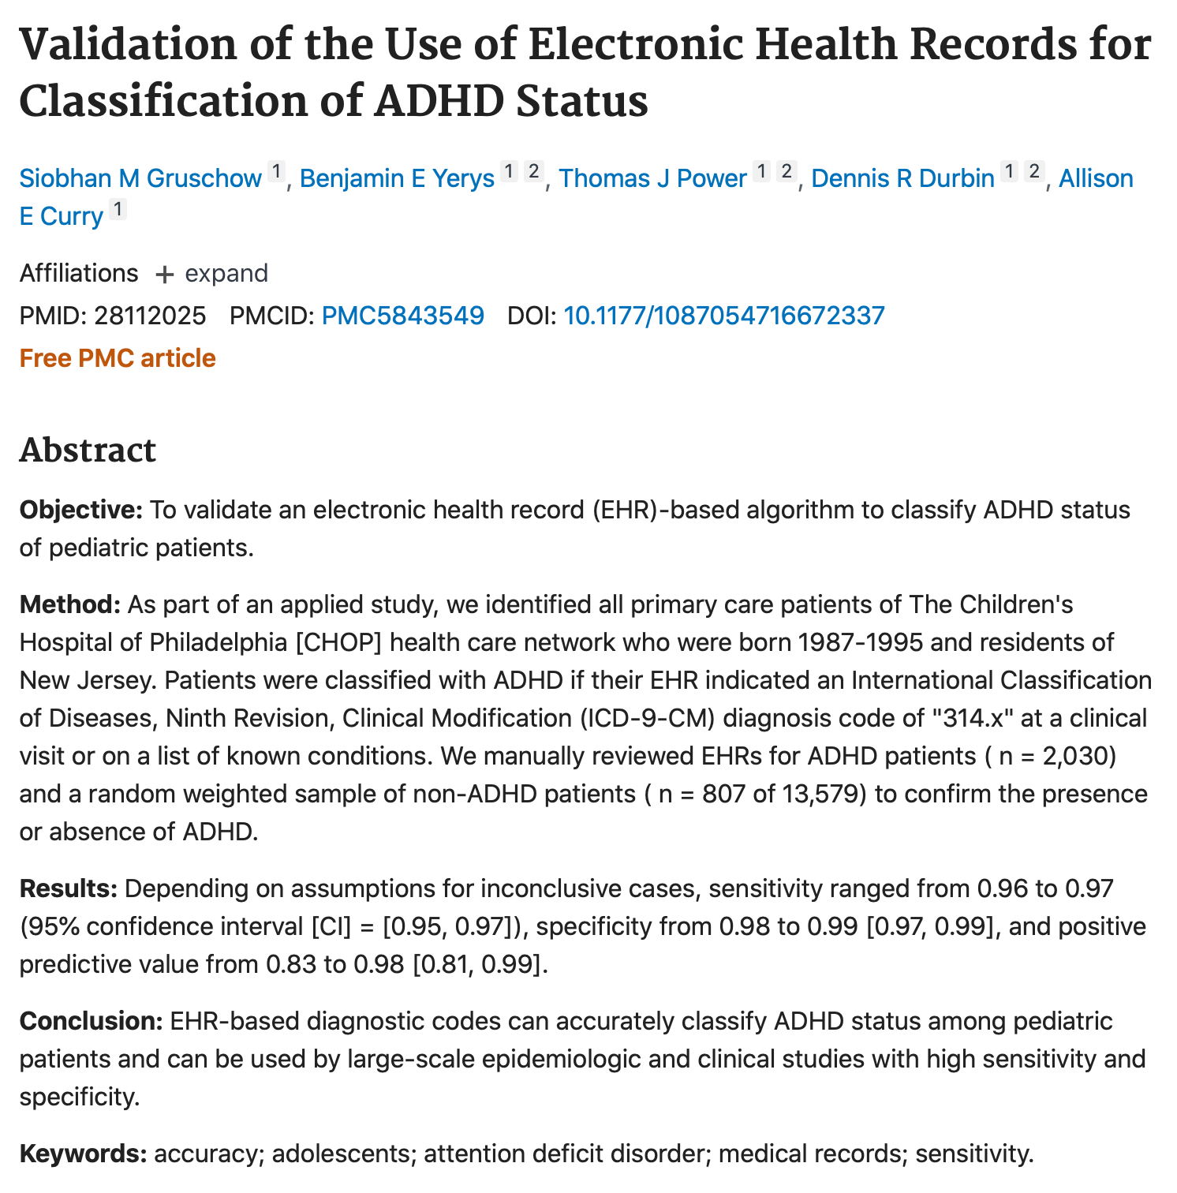
ADHD Computable Phenotype

Slide 11
What simplifications are we making?
$y_{i}$, autism diagnosis (yes/no)
$x_{i}$, data/features for patient i
Data are also collected over time…
Many values for a given feature. Which ones, and how many, do we use?

Slide 12
What’s in the EHR?
Structured Data

Slide 13
What’s in the EHR?
Structured Data
Demographics: don’t change over time -> EASY
Notes:
The only easy one

Slide 14
What’s in the EHR?
Structured Data
Demographics: don’t change over time -> EASY
Dx Codes: observed over time; thousands of codes
1 | 0 | 0 | 0 | 0 | 1 | 0 | 0
Code 1
Code 68,000
Notes:
Could be presence or absence – or could be counts

Slide 15
What’s in the EHR?
Structured Data
Demographics: don’t change over time -> EASY
Dx Codes: observed over time; thousands of codes
1 | 0 | 0 | 0 | 0 | 1 | 0 | 0
Code 1
Code 68,000
Notes:
Could be presence or absence – or could be counts
Too many codes… we will discuss ways to deal with this in our NLP section

Slide 16

What’s in the EHR?
Structured Data
Demographics: don’t change over time -> EASY
Dx Codes: observed over time; thousands of codes
Notes:
Could be presence or absence – or could be counts
Too many codes… we will discuss ways to deal with this in our NLP section

Slide 17
What’s in the EHR?
Structured Data
Demographics: don’t change over time -> EASY
Dx Codes: observed over time; thousands of codes
Encounter details
Notes:
Could be presence or absence – or could be counts
Too many codes… we will discuss ways to deal with this in our NLP section

Slide 18
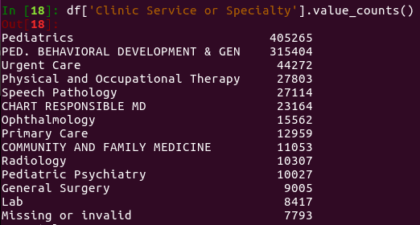
What’s in the EHR?
Structured Data
Demographics: don’t change over time -> EASY
Dx Codes: observed over time; thousands of codes
Encounter details
Notes:
Could be presence or absence – or could be counts
Too many codes… we will discuss ways to deal with this in our NLP section

Slide 19
What’s in the EHR?
Structured Data
Demographics: don’t change over time -> EASY
Dx Codes: observed over time; thousands of codes
Encounter details
Procedure Codes
Vitals
Labs
Notes:
Could be presence or absence – or could be counts
Too many codes… we will discuss ways to deal with this in our NLP section

Slide 20
What’s in the EHR?
Structured Data
Images*

Slide 21

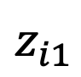
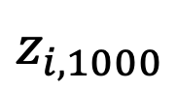
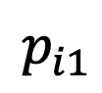
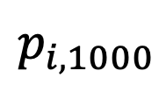
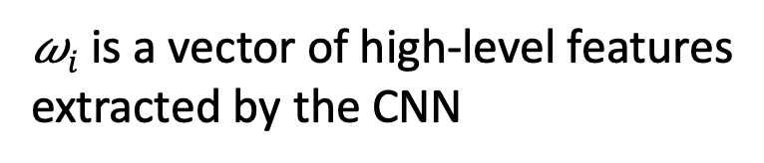
Use our CNN-based image representations…
$$p_{i1}$$
$$p_{i,1000}$$
$$pi = softmax(zi)$$
$$z_{i1}$$
$$z_{i,1000}$$
fully connected
𝜔_{i1}
𝜔_{iM}
𝜔$i$ is a vector of high-level features
extracted by the CNN
Convolutional Neural Network

Slide 22
Use our CNN-based image representations…
𝜔_{i1}
𝜔_{iM}
𝜔$i$ is a vector of high-level features
extracted by the CNN
Convolutional Neural Network

Slide 23
Use our CNN-based image representations…
𝜔_{i1}
𝜔_{iM}
Convolutional Neural Network
𝜔$i$ is a vector of high-level features
extracted by the CNN

Slide 24
Or CNN-based EEG representations…
𝜔_{i1}
𝜔_{iM}
Convolutional Neural Network
𝜔$i$ is a vector of high-level features
extracted by the CNN

Slide 25
A Simplified Approach…
$y_{i}$, autism diagnosis (yes/no)
Demographic features
Diagnosis features
Image features
Encounter features

Slide 26
What’s in the EHR?
Structured Data
Images*
Clinical Notes

Slide 27
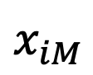
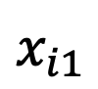
How do we represent notes numerically?
???
$$x_{i1}$$
$$x_{iM}$$

Slide 28
How do we represent notes numerically?
count words
dyspnea (present/absent)
craniotomy (present/absent)

Slide 29
How do we represent notes numerically?
count words
Word 1
Word 6 billion

Slide 30
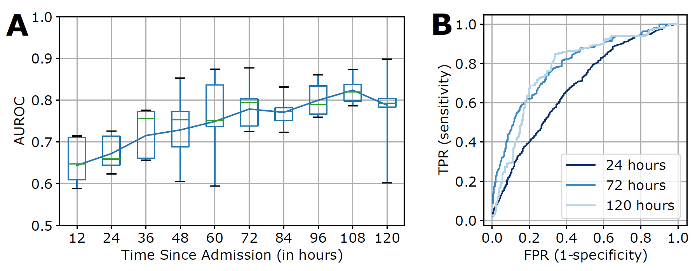
Prediction over Time
Turpin et al., Machine Learning Prediction of Surgical Intervention for Small Bowel Obstruction (forthcoming)
Notes:
1 – incorporate temporal information (e.g., time of diagnosis code)
2 -

